Slide 1
NSCAP
@CS.NCTU
Project Checkpoint#1: OpenWrt Installation
Instructor: Kate Lin

Slide 2
Objectives
In this checkpoint, we are going to install OpenWrt on router, and setup the wifi on it You’ll learn:
How to build OpenWrt images
How to install OpenWrt
How to setup Wi-Fi in OpenWrt

Slide 3
Intro. to OpenWrt

Slide 4
OpenWrt
A Linux Distribution designed for embedded devices to route network traffic
Lots of software packages are available for installation, providing network functions that are not supported by stock firmware

Slide 5
Tasks

Slide 6
Tasks
Building OpenWrt images
[Method 1] Self-compile (Build system)
[Method 2] Using the Image Builder
Install OpenWrt via Edimax router’s web UI
Enable and configure Wi-Fi
[Method 1] Using terminal
[Method 2] Using web UI
Configure WAN (optional)
[Method 1] Using terminal
[Method 2] Using web UI

Slide 7
Build OpenWrt Images
Self-compile (Build system)

Slide 8
Environment
Install the virtual machine (if necessary)
Recommended specifications of VM
OS: Ubuntu 20.04
CPU: 2 up
RAM: 4GB up
Disk size: 40GB up
If you don’t satisfied the recommended spec, you can try to use GitHub Actions as your build environment

Slide 9
Build Images
Install building dependencies
# sudo apt update
# sudo apt install build-essential\ ccache ecj fastjar file g++ gawk\ gettext git java-propose-classpath\ libelf-dev libncurses5-dev\ libncursesw5-dev libssl-dev python\ python2.7-dev python3 unzip wget\ python3-distutils python3-setuptools\ python3-dev rsync subversion swig time\ xsltproc zlib1g-dev

Slide 10
Build Images
Clone OpenWrt project, select the latest release version, update building feeds, and get default building config for ramips/mt7620 series
# git clone\ https://git.openwrt.org/openwrt/openwrt.git
# cd openwrt
# git pull
# git branch –a --- Check all branches
# git checkout --track\ origin/openwrt-21.02 --- Optional

Slide 11
Build Images
Cont’d
# git tag --- Check all tags (release version)
# git checkout v21.02.2
# ./scripts/feeds update –a &&\ ./scripts/feeds install –a
# wget\ https://downloads.openwrt.org/releases/21.02.2/targets/ramips/mt7620/config.buildinfo -O .config ---Download config file

Slide 12
Build Images
Setup building config
# cd ~/openwrt
# make menuconfig

Slide 13
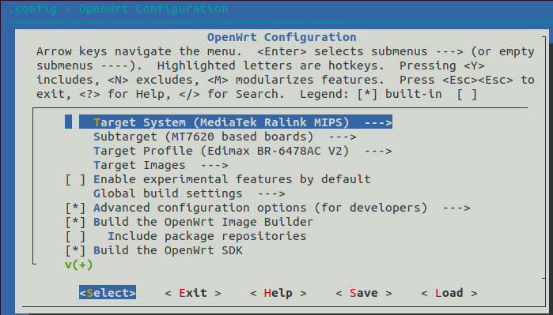
Build Images
After setting up building config, you will enter the appearance below

Slide 14
Build Images
Load default config for ramips/mt7620 series first
Use left and right arrow to highlight < Load >, and then press enter to select
Press enter again to load the config
Now
--- Target System should be MediaTek Ralink MIPS
--- Subtarget should be MT7620 based boards
Change target profile to Edimax BR-6478AC V2
Use up and down arrow to highlight Target Profile, and then press enter to select
Use up and down arrow to highlight Edimax BR-6478AC V2, and then press space to select

Slide 15
Build Images
Deselect following packages to save more space
(N) LuCI → Collections → luci-ssl
(N) LuCI → Collections → luci
(N) LuCI → Protocols → luci-proto-ipv6
(N) LuCI → Protocols → luci-proto-ppp
(N) Libraries → rpcd-mod-rrdns
(N) Network → Firewall → ip6tables
(N) Network → odhcp6c
(N) Network → odhcpd-ipv6only
(N) Network → ppp-mod-pppoe
(N) Network → ppp
(N) Utilities → Encryption → px5g-wolfssl
(N) Utilities → iwinfo

Slide 16
Build Images
Select following packages
(Y) Network → Open vSwitch → openvswitch
Change image distribution name to proof that this image is self-compile
Image configuration → Version configuration options → Release distribution
Change it from “OpenWrt” to your student id number
Save & Exit
Build the image
# make -j $(nproc) defconfig download\ clean world

Slide 17
Find your image
Once you complete the building process, you can find your image in following location
/home/nscap/openwrt/bin/targets/ramips/mt7620/ <student id>-21.02.2-ramips-mt7620-edimax_br- 6478ac-v2-squashfs-sysupgrade.bin

Slide 18
Build OpenWrt Images
Using the Image Builder

Slide 19
Build Images
Recommended disk size for VM : 50GB
Install building dependencies
# sudo apt update
# sudo apt install build-essential\ libncurses5-dev libncursesw5-dev \
zlib1g-dev gawk git gettext libssl-dev\ xsltproc rsync wget unzip python

Slide 20
Build Images
Download image builder
# wget\ https://downloads.openwrt.org/releases/21.02.2/targets/ramips/mt7620/openwrt-imagebuilder-21.02.2-ramips-mt7620.Linux-x86_64.tar.xz
--- Download mt7620 series image builder
# tar Jxvf\ openwrt-imagebuilder-21.02.2-ramips-mt7620.Linux-x86_64.tar.xz
--- Decompress the downloaded file

Slide 21
Build Images
Build the image
# make image PROFILE=edimax_br-6478ac-v2 PACKAGES="-ppp-mod-pppoe -ppp -odhcp6c -ip6tables -odhcpd-ipv6only -kmod-pppoe -kmod-ip6tables uhttpd uhttpd-mod-ubus luci-mod-admin-full luci-app-firewall luci-app-opkg luci-theme-bootstrap openvswitch"

Slide 22
Find your image
Once you complete the building process, you can find your image in following location
/home/nscap/openwrt/bin/targets/ramips/mt7620/ openwrt-21.02.2-ramips-mt7620-edimax_br-6478ac-v2-squashfs-sysupgrade.bin

Slide 23
Install OpenWrt

Slide 24
Install OpenWrt
Connect to Edimax via Wi-Fi or ethernet
Login to Edimax web UI
http://192.168.1.1
Account/Password: check manual

Slide 25
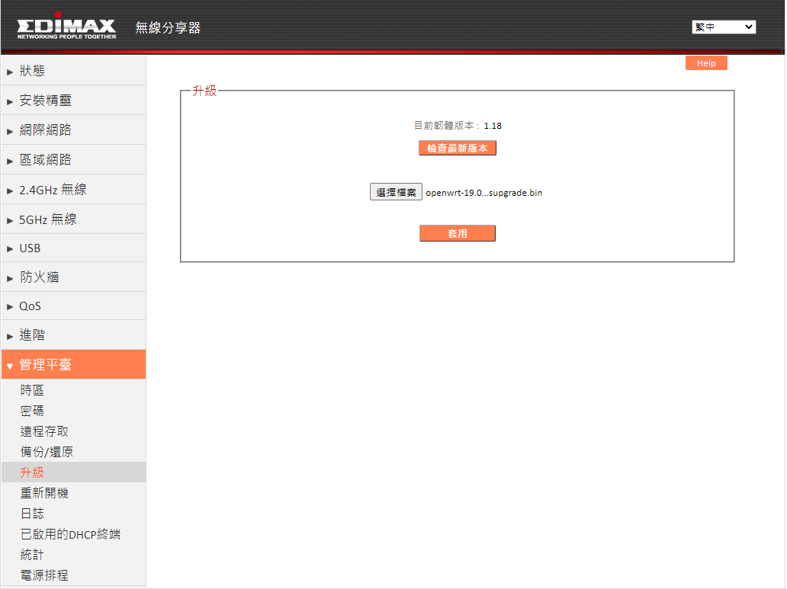
Install OpenWrt
Use Edimax web UI’s upgrade tool to install OpenWrt

Slide 26
Enable and Configure Wi-Fi
Using Terminal

Slide 27
Enable and Configure Wi-Fi
Connect to the router via ethernet
Since Wi-Fi is disabled by default after you do a fresh install of OpenWrt
Login to OpenWrt via SSH using your computer
# ssh root@192.168.1.1
Contact TA if you have waited for 10 mins and still can’t ssh into it
Change root’s password first
# passwd

Slide 28
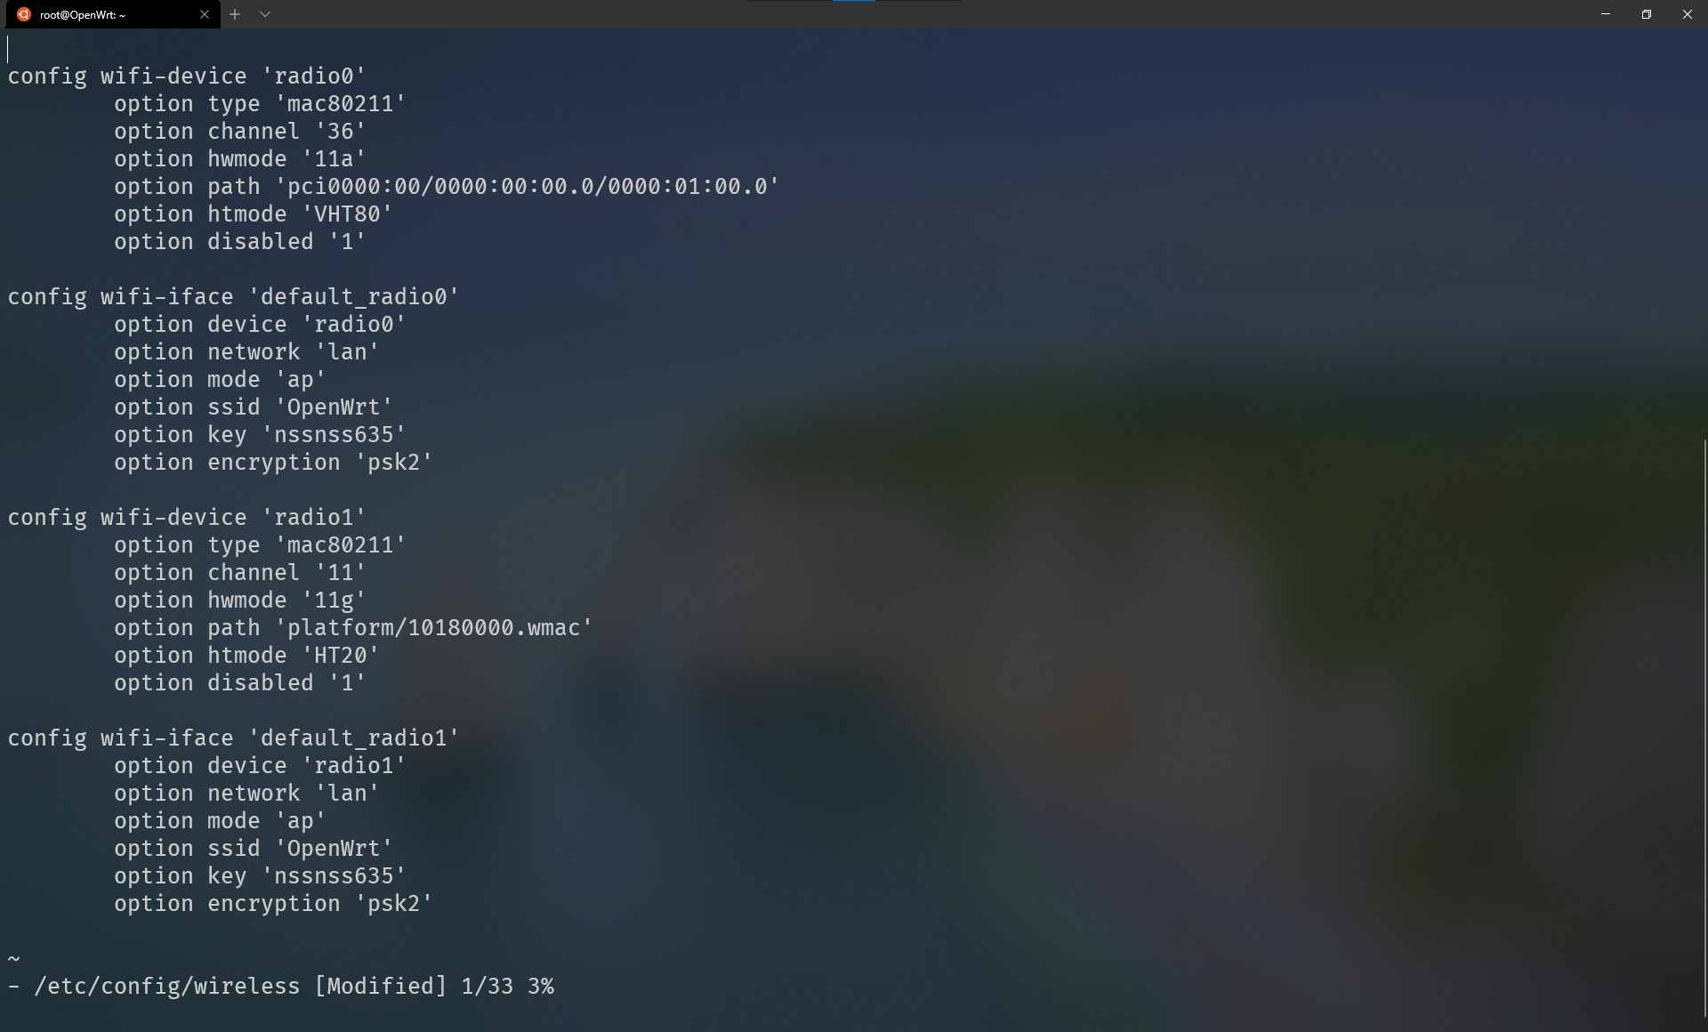
Enable and Configure Wi-Fi
Enable 2.4GHz/5GHz Wi-Fi
# vim /etc/config/wireless
Change config file like below:
5Ghz
Remove this line to enable Wi-Fi
2.4Ghz
Remove this line to enable Wi-Fi

Slide 29
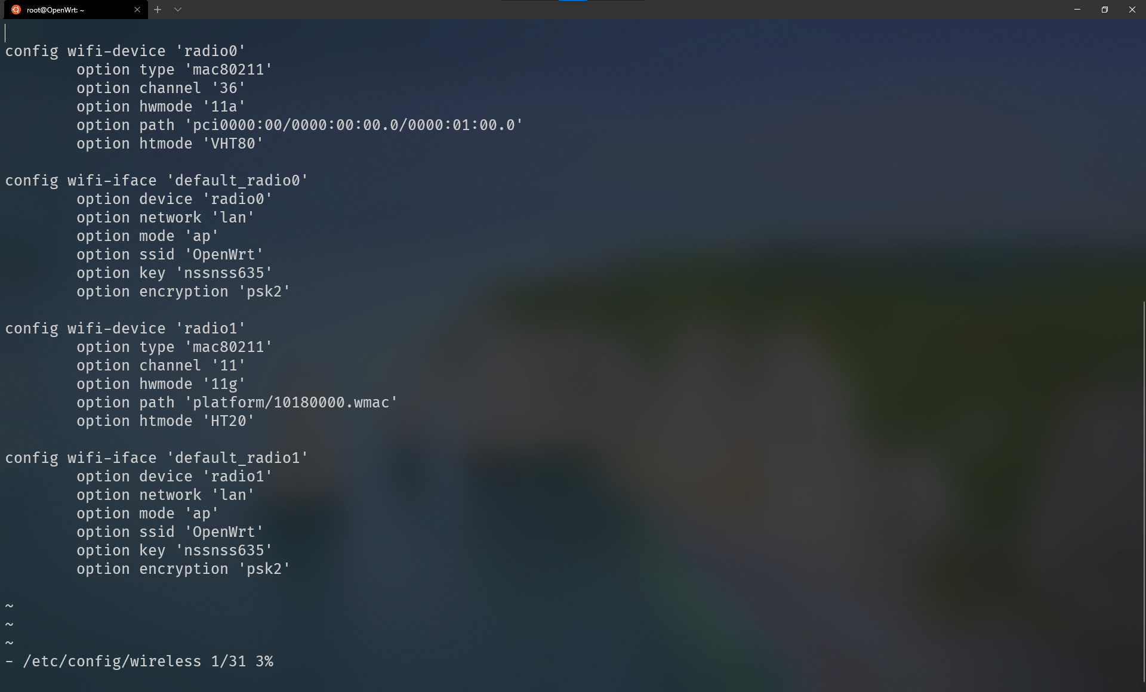
Enable and Configure Wi-Fi
Enable 2.4GHz/5GHz Wi-Fi
# vim /etc/config/wireless
Change config file like below:
5Ghz
Set Wi-Fi’s SSID
Set Wi-Fi’s password
Set encryption method (psk2 means WPA2)
2.4Ghz
Set Wi-Fi’s SSID
Set Wi-Fi’s password
Set encryption method (psk2 means WPA2)

Slide 30
Enable and Configure Wi-Fi
Restart Wi-Fi
# wifi
You can find your AP and connect to it

Slide 31
Enable and Configure Wi-Fi
Using Web UI

Slide 32
Enable and Configure Wi-Fi
Connect to the router via ethernet
Since Wi-Fi is disabled by default after you do a fresh install of OpenWrt
Login to OpenWrt web UI
http://192.168.1.1
Username/Password: root/root
Change admin’s password first
Goto System -> Administration

Slide 33
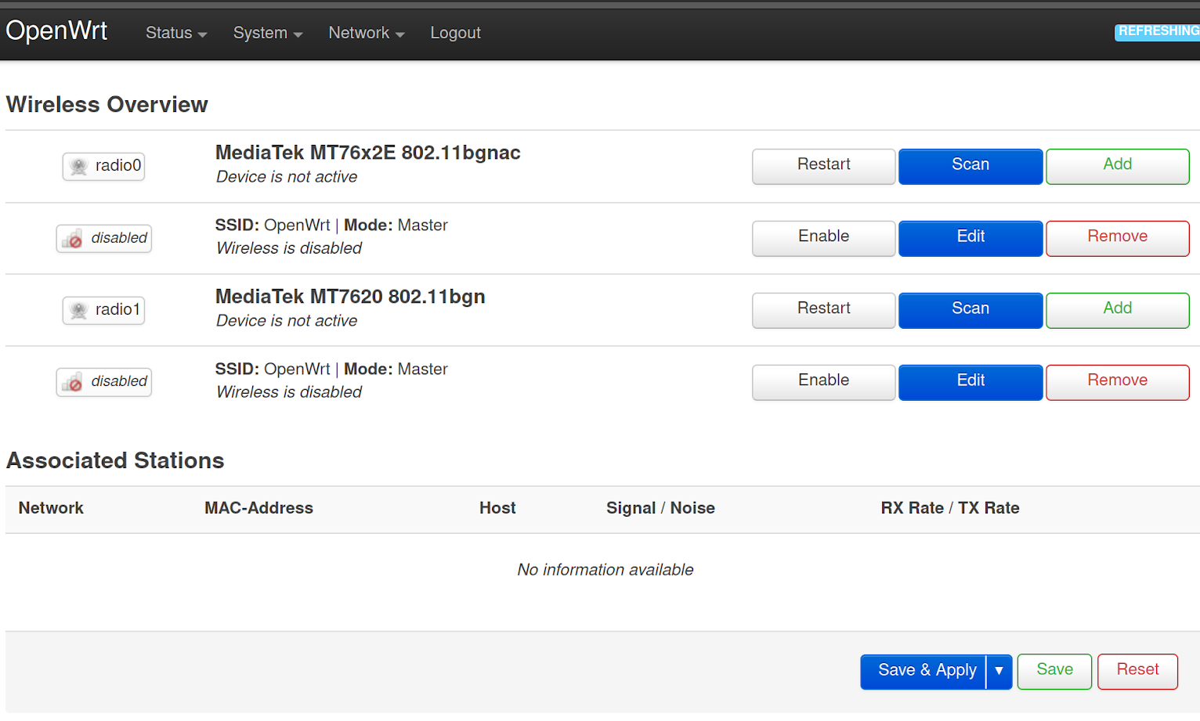
Enable and Configure Wi-Fi
Enable 2.4GHz/5GHz Wi-Fi
Goto System -> Wireless
Click Enable
5Ghz
2.4Ghz

Slide 34
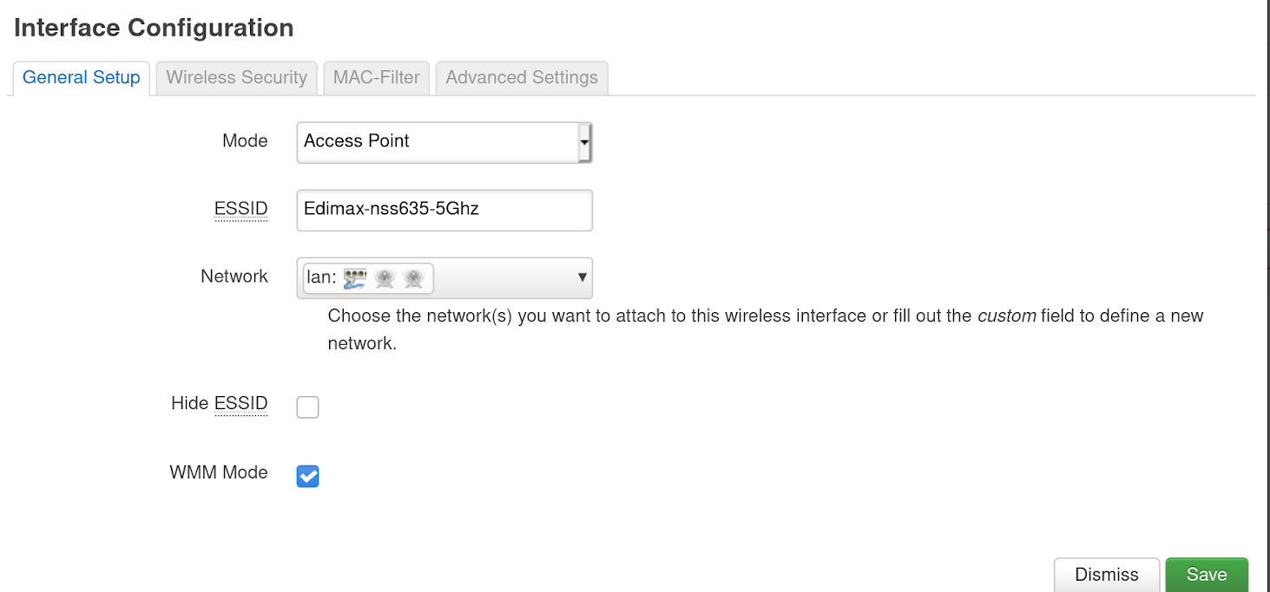
Enable and Configure Wi-Fi
Configure 2.4GHz/5GHz Wi-Fi
Click Edit
ESSID: <router’s name>

Slide 35
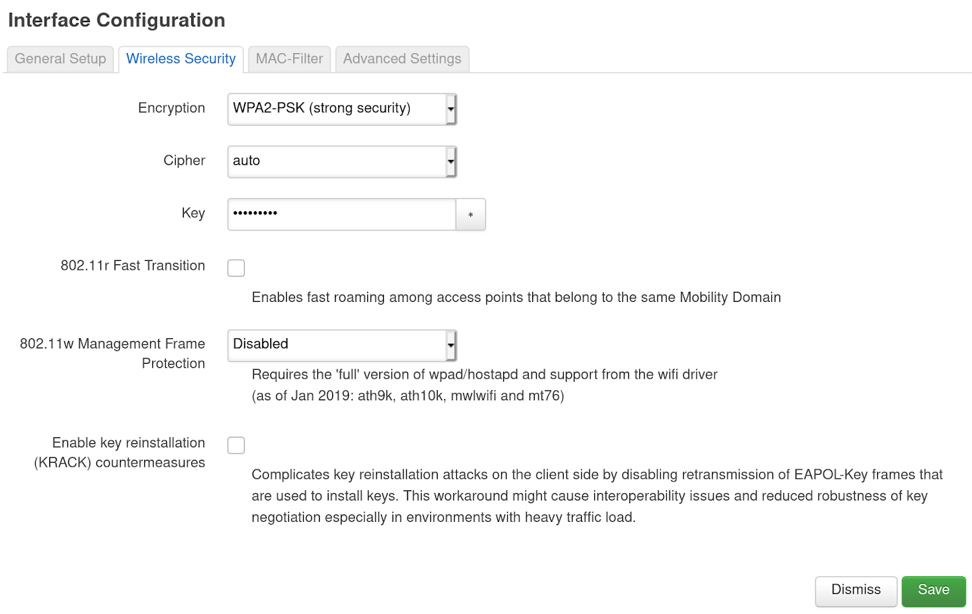
Enable and Configure Wi-Fi
Configure 2.4GHz/5GHz Wi-Fi (cont.)
Click Wireless Security
Encryption: WPA2-PSK
Key: <router’s password>
Click Save&Apply

Slide 36
Configure WAN (optional)
Using Terminal

Slide 37
Configure WAN (optional)
If your gateway router use DHCP, then you can skip this part
Otherwise, we have to manually configure IP address on our router

Slide 38
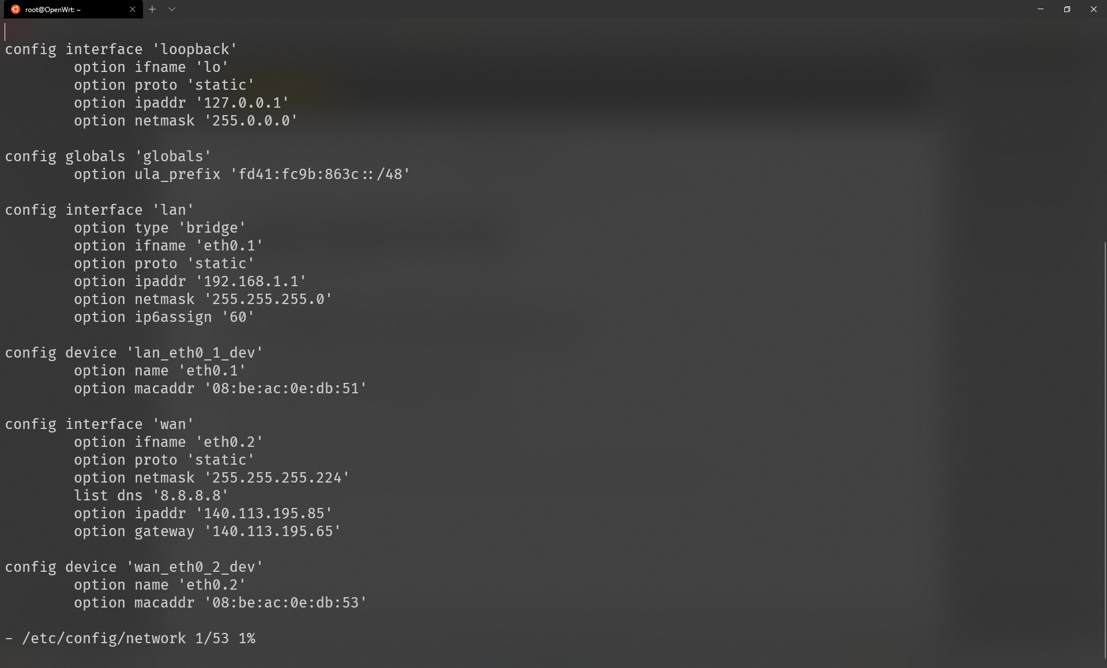
Configure WAN (optional)
After you ssh into the AP, you can
# vim /etc/config/network
Change config file like below:
IPv4
“eth0.2” is the WAN port behind the router
Set proto to “static” means you want to use static IP
Set your netmask
Set your DNS (this is optional)
Set your static IP address
Set your gateway

Slide 39
Configure WAN (optional)
There’s also an interface in /etc/config/network called “wan6” for IPv6
Reload Network
# /etc/init.d/network reload

Slide 40
Configure WAN (optional)
Using Web UI

Slide 41
Configure WAN (optional)
If your gateway router use DHCP, then you can skip this part
Otherwise, we have to manually configure IP address on our router

Slide 42
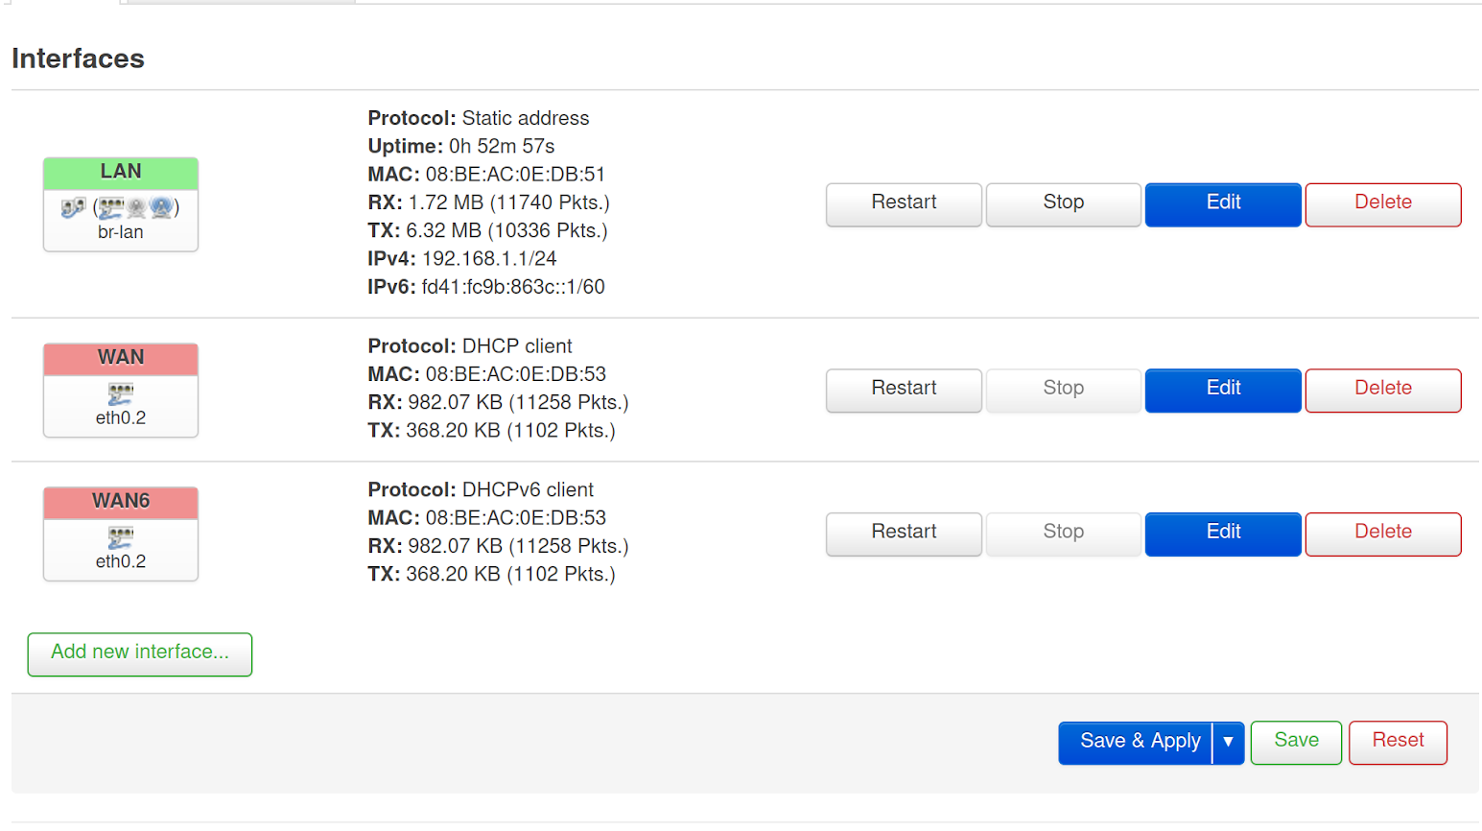
Configure WAN (optional)
Goto Network -> Interfaces
Click Edit
Protocol: Static address
Click Switch Protocol
IPv4
IPv6

Slide 43
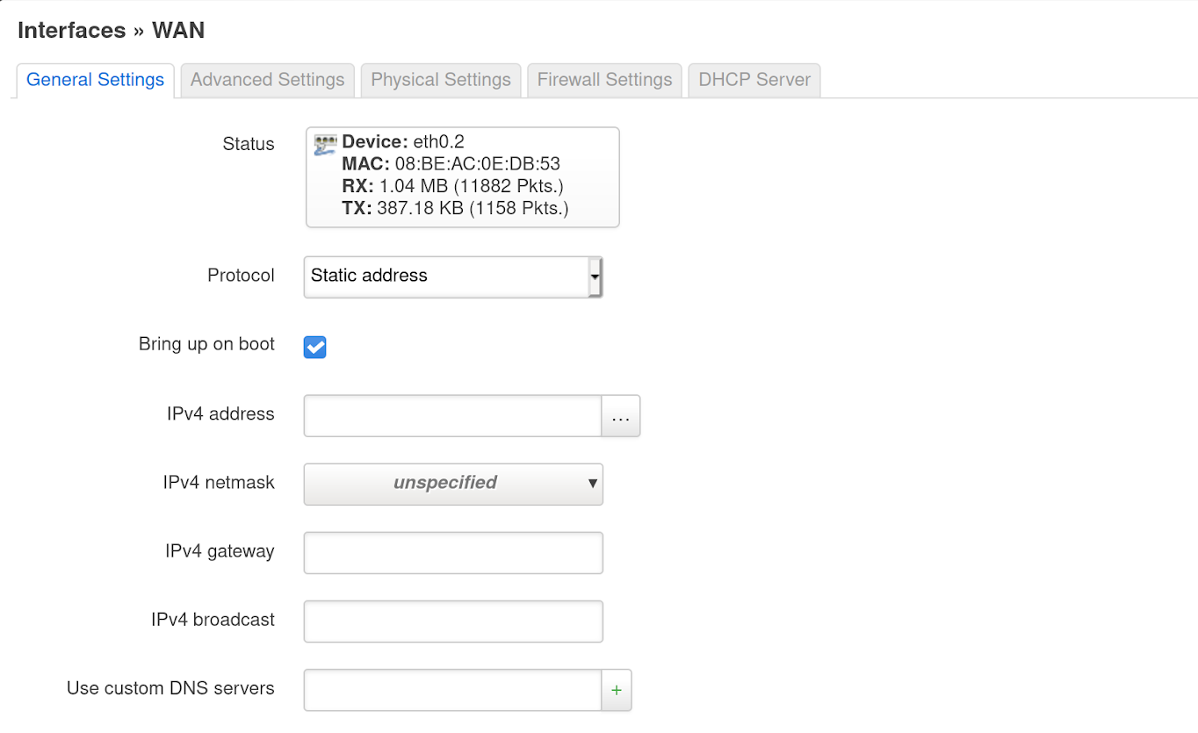
Configure WAN (optional)
Configure WAN
Protocol: Static address
Click Switch Protocol
Configure following attributes by yourself

Slide 44
Configure WAN (optional)
Your mobile devices can now access Internet via your OpenWrt router :-)

Slide 45
Submission

Slide 46
Grading Policy
Report(100%)
Building images (50%)
Use self-compile or image builder (only get 70% of score in this part if using image builder)
Briefly explain the process to complete this part
Screenshots
2. Install OpenWrt (20%)
Screenshots
3. Enable and Configure Wi-Fi (or WAN) (20%)
Screenshots
4. Thoughts on this Project (10%)
Difficulties encountered
Suggestion if any

Slide 47
Screenshots
Please providing at least the following screenshots :
The welcome screen after ssh to router
The result after execute the following command
# ovs-ctl -V
# ubus call system board
# wifi status
# ping 8.8.8.8
“respectively…”
Please take screenshots by yourself (Do not directly take what we provided or using classmates’)

Slide 48
Reference
https://openwrt.org/docs/guide-developer/toolchain/beginners-build-guide
https://openwrt.org/docs/guide-developer/toolchain/install-buildsystem
https://openwrt.org/docs/guide-user/additional-software/saving_space
https://openwrt.org/docs/guide-user/additional-software/imagebuilder
https://openwrt.org/docs/guide-developer/toolchain/use-buildsystem
https://openwrt-nctu.gitbook.io/project/
https://upsangel.com/openwrt/openwrt-beginner-guide/
https://zh.wikipedia.org/wiki/OpenWrt

